Slide 1
Finance & Risk Analytics
Submitted by:
Amit
Mahesh
Akash

Slide 2
Agenda
Objective
Insights & Visualization
Stocks Data Overview
Stocks Visualization
Sector-Wise Analysis
Key Findings in Stocks
Portfolio Analysis
Methodology

Slide 3
Objective
We're examining a stock portfolio to provide investment guidance based on the needs of two clients:
Mr. Patrick Jyenger is looking to invest $500K in stocks.
He follows a conservative investment approach, prioritizing low risk.
His goal is to double his capital within a 5-year timeframe.
Mr. Patrick Jyenger:
Mr. Peter Jyenger plans to invest $1 million in equities.
He's a high-risk investor, seeking the potential for higher returns.
His objective is to double his capital within a 5-year period.
Mr. Peter Jyenger:

Slide 4
Insights & Visualization

Slide 5
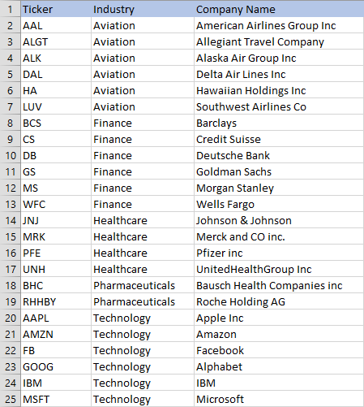
Stocks Data Overview
We have a total of 24 stocks categorized into four sectors, with each sector comprising 6 stocks.
We also have the S&P500 index, which represents the top 500 stocks in the US stock market.
Here's a list of the stocks, including their abbreviations, industries, and company names.

Slide 6
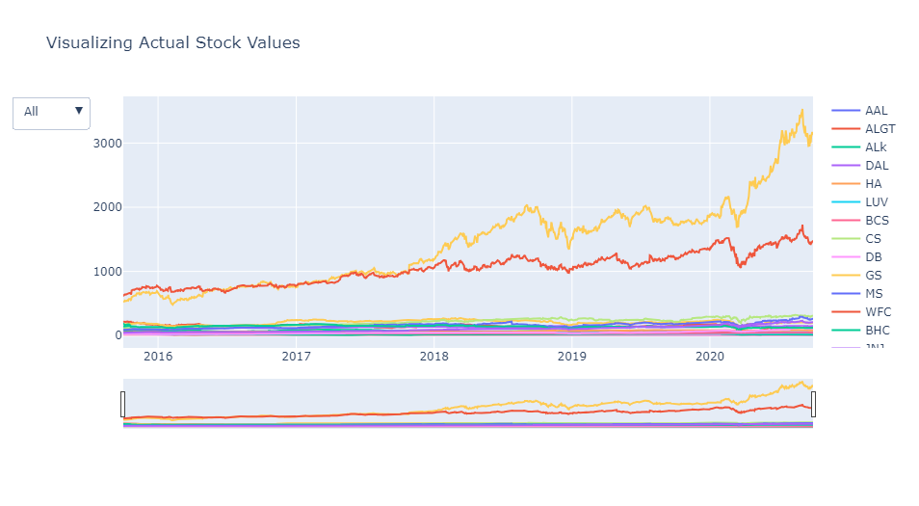
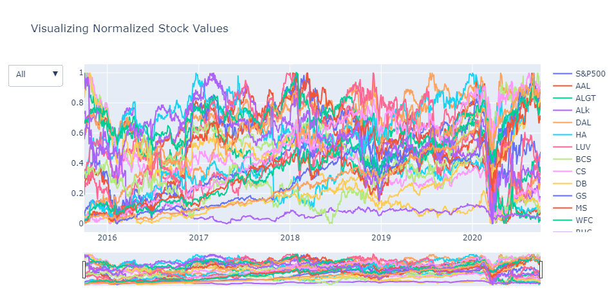
Stocks Visualization
Actual Stocks Data
Normalized Stocks Data
Stock Performance Over 5 Years:
The chart above shows the 5-year performance of all stocks.
It's clear that Amazon and Microsoft have outperformed other stocks during this period.
Stocks vs. S&P500 Index:
This chart compares stock performance with the S&P500 index.
Remarkably, 8–9 stocks outperformed, achieving returns exceeding 80% in the 5-year period.

Slide 7
Sector – Wise Analysis

Slide 8
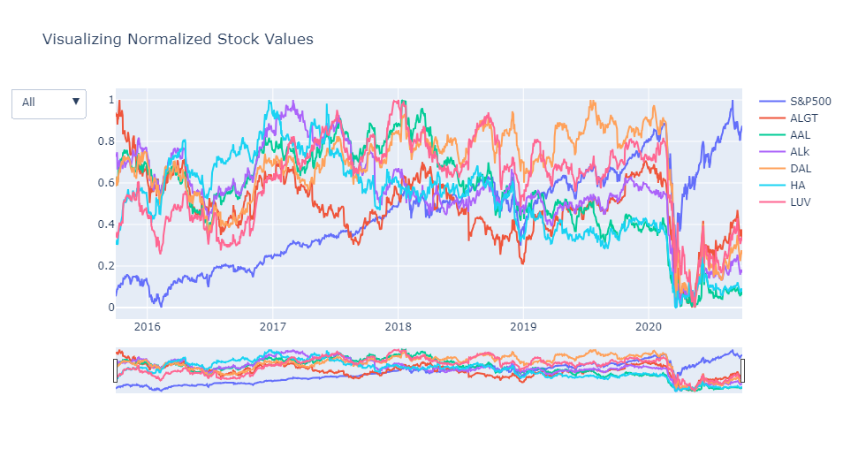
Aviation Sector
The aviation sector took a severe hit in March 2020 due to the COVID-19 pandemic, and it hasn't fully bounced back since.
Despite a rising market index, this sector continues to face challenges.

Slide 9
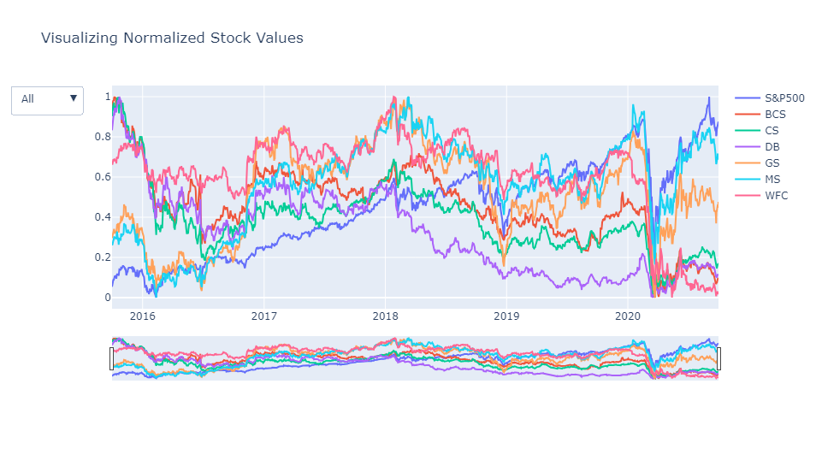
Finance Sector
Due to Corona Pandemic hit in March 2020 Finance sector has also faced a major crisis and the sector has recovered a bit, although majority of stocks has been hit.
Morgan Stanley & Goldman Sachs have performed well when compared to other stocks.

Slide 10
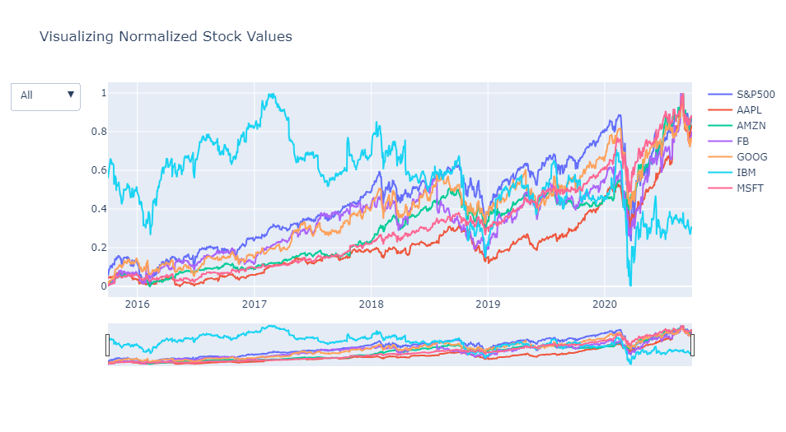
Technology Sector
Due to Covid Pandemic hit in March 2020 Technology Sector has also faced crisis but the recovery rate shown by this sector is commendable.
Key players like Microsoft, Amazon, Apple, Facebook, and Google have not only rebounded but also performed well, aligning with the market index.
On the flip side, IBM has consistently underperformed compared to other stocks in the same sector over the years

Slide 11
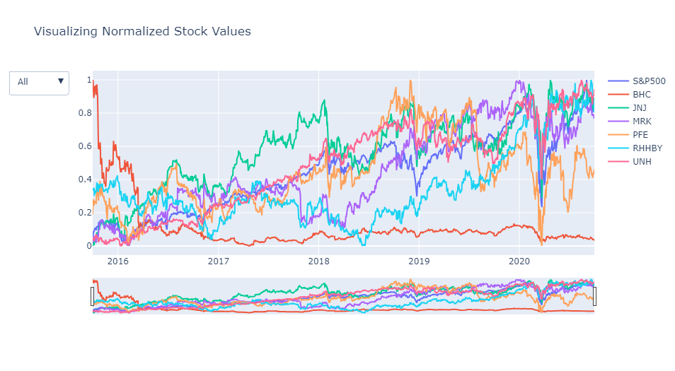
Healthcare & Pharma Sector
The COVID-19 pandemic had a significant impact on the pharmaceutical and healthcare sector in March 2020. However, this sector has showcased an impressive recovery.
United Health, Johnson & Johnson have performed well when compared to S&P Index.
Bausch Health has consistently underperformed compared to other stocks in the same sector over the years

Slide 12
Key Findings in Stocks

Slide 13
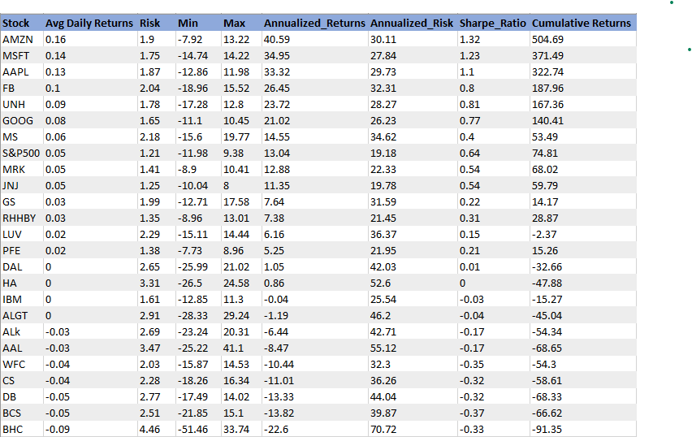
Top 8 Stocks with Returns more Than 80% in 5 Years
Annual Returns of Selected Stocks:
•AMZN: 40.59%
•MSFT: 34.95%
•AAPL: 33.32%
•FB: 26.45%
•UNH: 23.72%
•GOOG: 21.02%
•MS: 14.55%
•S&P500: 13.04%

Slide 14
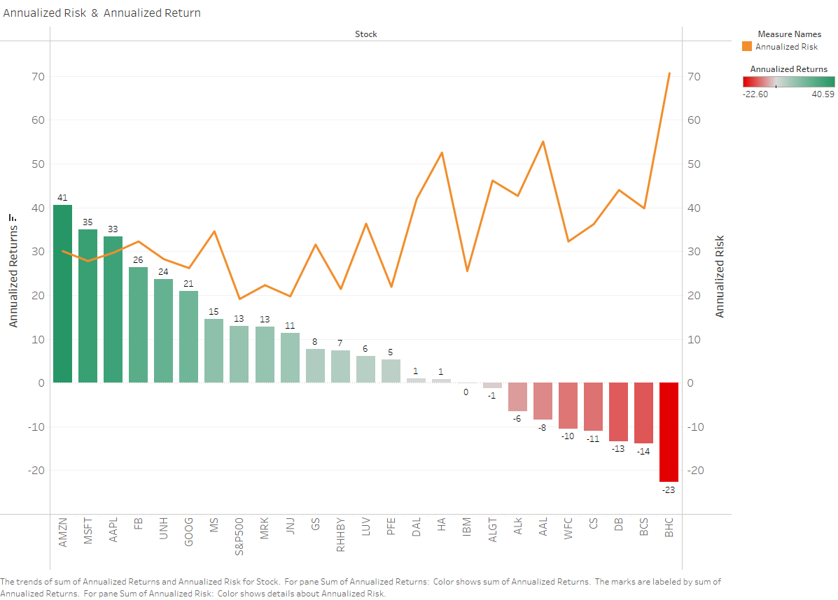
Annualized Risk & Annualized Return
The top five stocks by annualized return are AMZN, MSFT, AAPL, FB, and UNH.
The annualized return on each of the top 5 stocks is greater than 20. Compared to other equities, the risk of these five stocks is moderate.
Lower returns increase the likelihood of losing the initial investment.
BHC, BCS, DB, CS, and WFC have higher risk as they didn't provide returns on the initial investment.
Lower ROI indicates higher risk in stocks. However, some stocks may not offer high returns but provide a risk-free investment opportunity.
JNJ, RHHBY, MRK are stocks with less risk and good returns.

Slide 15
Portfolio Analysis

Slide 16
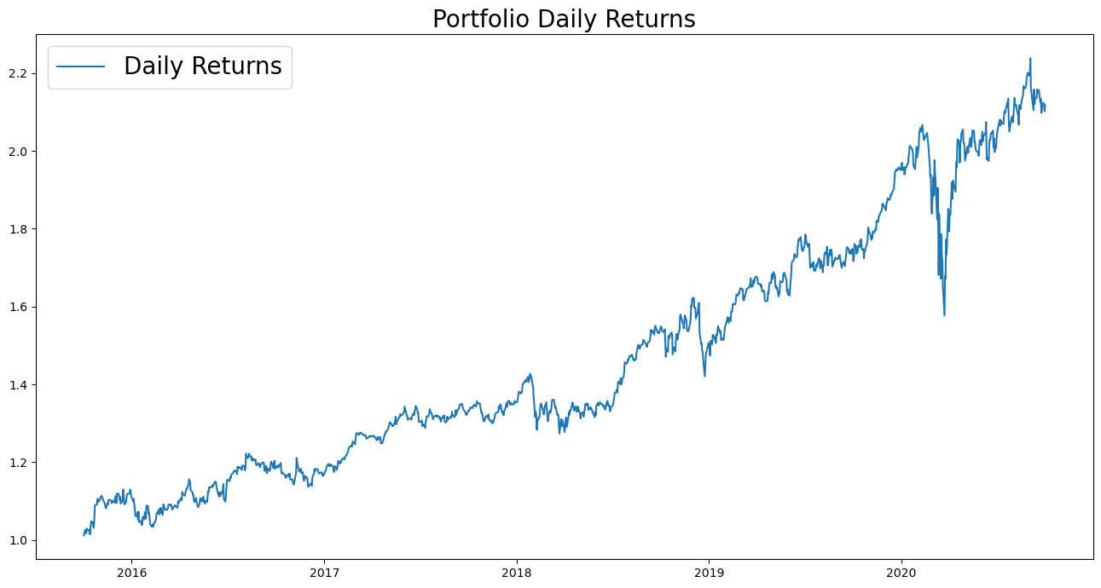
Portfolio analysis
Patrick Jyengar Portfolio
Investment Goal: Double the investment in 5 years with decent returns and low risk.
Preferred Stocks: JNJ, RHHBY, MRK are suitable due to their low risk.
However, these three stocks wouldn't alone reach the desired returns.
A portion of the investment can be allocated to MSFT to achieve the target returns.
Equal weightage of 0.25 is allocated to all stocks.
Investment: ($500 K) in equities.
Expected Returns: ($1.05 Million) after 5 years.
Gain on Investment: ($558 K).

Slide 17
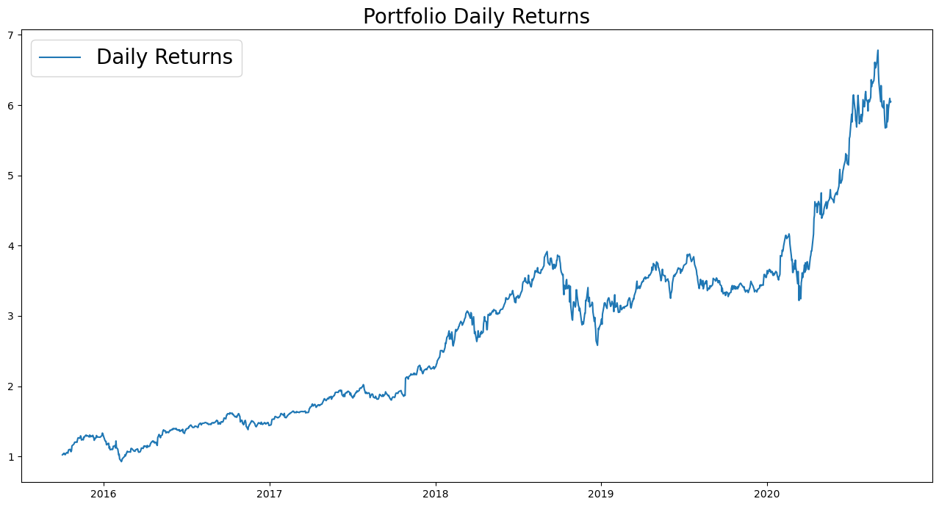
Portfolio analysis
Peter Jyengar Portfolio
Investment Goal: High-return investments for inorganic expansion of the company, accepting high risk.
Preferred Stock: AMZN, MSFT suitable due to its high-risk/high-reward nature.
Believes in bouncing back from occasional losses.
Investment: ($1 Million) from company's cash and cash equivalents.
Expected Returns: More than ($6 Million) after 5 years.
Gain on Investment: More than $5 Million.
Focus on maximum returns and managing associated risk.

Slide 18
Methodology

Slide 19
Methodology
01
Understanding Problem
Data Analysis and Getting Insights
Data Understanding
05
02
Solving Problem
Missing / Null Values Treatment
04
03
Data Cleaning & Manipulation

Slide 20
Methodology
01
Exploratory Data Analysis:
Checked for null values (none found).
No null values in Rows & Columns.
Examined the dataset for outliers.
02
Calculated daily returns, cumulative returns, Sharpe ratio, portfolio risk, and ROI.
Identified the top-performing stocks.
Discovered 8 to 9 stocks with over 80% returns in the last five years.
Data Analysis Highlights:
03
Top-Performing Stocks:
AAPL, AMZN, FB, GOOG, MSFT, UNH, RHHBY, MS
Performed sector-wise analysis to get a better view of each sector.
04
Risk and Returns:
Each stock carries different levels of risk and liability.
AMZN offers high returns but comes with high risk.
Stocks like JNJ, RHHBY, MRK, and MSFT offer good returns with lower risk.
05
Conclusion:
Finalized portfolios for both customers based on analysis.

Slide 21
Thank You

